Slide 1

Implementation of Keylogger Spyware Attacks
Submitted by
Under the Guidance
Dr. P. Vijayakumar
School of Electronics Engineering
VIT University, Chennai
DONE BY:
Rahul Anil Nair

Slide 2

Overview
Objective of the Project
Introduction
Related Work
What is keylogger?
Block Diagram
Uses Of Keylogger
Advantage
Limitation
Proposed Method
Description
Hardware Unit
Software Unit
Summary
References

Slide 3
Objective of the Project
●Everything that is typed will be logged; this includes sensitive information such as passwords, names, pin numbers, and even credit card numbers.
●The keylogger will record all the activities related to keystrokes, the recording process is accomplished by using string matching method.

Slide 4
Introduction
Security is essential in an operating system, and there are many software vendors that provide antivirus software and other protection software so that the computer is free from threats or unwanted actions such as phishing, malware, keylogger and others. Keylogger is a tool that most progressed because this application is very rarely recognized as a malicious program by antivirus , the function of keylogger will record all activities related to the emphasis on the keyboard keys or activity on the operating system . Email addresses and passwords even up to a Facebook account with passwords can be stolen with keylogger apps without the realization of computer users. String matching is a method of character matching from input process like a keyboard, and matching process is done by checking every incoming character. The use of string matching algorithms on keylogger applications used to record user activity will be more comfortable and faster.
Notes:
security

Slide 5
Related Works
[1] A method for securing username and password against the Keylogger software using the logistic map chaos function
(Publisher: IEEE)
M. Hossein Ahmadzadegan; Ali-asghar Khorshidvand; Mehrdad Pezeshki
[2] Keylogger Is A Hacking Technique That Allows Threatening Information On Mobile Banking User
Adam Prayogo Kuncoro; Bagus Adhi Kusuma

Slide 6
[3] Keyloggers software detection techniques
(Publisher: IEEE)
A. Solairaj; S. C. Prabanand; J. Mathalairaj; C. Prathap; L. S. Vignesh
[4] A framework for detection and prevention of novel keylogger spyware attacks
(Publisher: IEEE)
Mohammad Wazid; Avita Katal; R.H. Goudar; D.P. Singh; Asit Tyagi; Robin Sharma; Priyanka Bhakuni
[5] Infringement of Prevention Technique against Keyloggers using Sift Attack
(Publisher: IEEE)
Arun Pratap Singh; Vaishali Singh

Slide 7
What is keylogger?
A keylogger is a type of surveillance software that has the capability to record every keystroke you make to a log file, usually encrypted.
Keystroke logging often cited as ‘keylogging,’ is the practice of covertly recording input signals from a computer keyboard when the computer user is not aware. It is the equivalent of digital surveillance, revealing every click and touch, every download and conversation.
Keylogging hacking is used to steal personal or financial information such as banking details, which they can then sell or use for profit. However, they also have legitimate uses within businesses to troubleshoot, improve user experience, or monitor employees. Law enforcement and intelligence agencies also use it for surveillance purposes.
Authorized programs may require a keylogging function, which can be used to call certain program functions using ‘hotkeys’ or toggle between keyboard layouts (e.g., Keyboard Ninja). There is a lot of licensed software designed to allow administrators to keep an eye on what employees do during their shifts or enable users to track third parties’ activity on their computers. However, the ethical boundary between permissible monitoring and cyberespionage is a fine line.

Slide 8
Methodology
Hardware Keylogger involves bombarding a ghost device with the primary target machine. The ghost device act as a man in the middle between the motherboard and the keyboard, implementing this requires physical access to the target machine.
STEPS 1. Insert a pen-drive to infect the system.
2. An exe file will initiate the Keylogger attack.
The file containing the keylogger code is the compiled and renamed as an application file.
3. Batch files for infecting and collecting data will be created.
3. A log file will be generated with the encrypted logs in ASCII Value.
4. Another .exe file - will generate a file containing data which will decrypt the data.

Slide 9
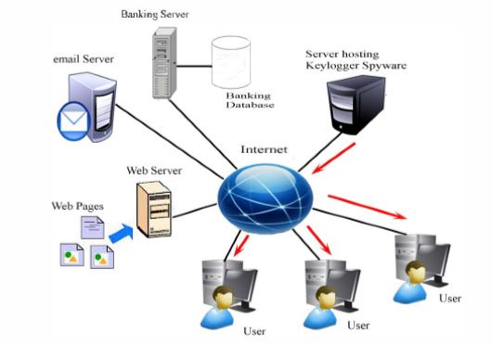
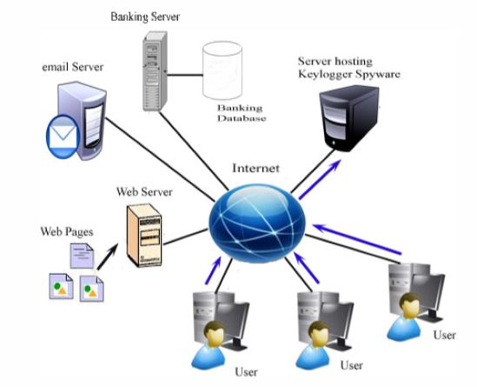
The keylogger script stores every keystroke into a
file and generates a log file then the spy script email this log file to the designer’s specified address.

Slide 10

Keylogger Spyware Algorithm
Exact string matching algorithm
This algorithm is used to match keyboard input variables with input received from the keyboard, and exact string matching is a method that can be done to match input string variable with string comparison variable, for testing of exact string matching algorithm on keylogger application can be assumed in the following example:

Slide 11
Proposed Algorithm
Keylogger_Algorithm ( ) { //Algorithm for keystroke capturing While (true) { • Open the log file in write mode (Record.log) • Get the system time using time.h API in C and enter that time in log file. • Append the time in the log file. • Get the activity by tapping the keystrokes and mouse clicks. It can be done in using windows.h and Winuser.h API available in C compilers. • Enter the activity into log file as soon as the valid status of particular key is pressed or mouse click is observed. • Close the file and terminate all the file pointers. • Open the file in append mode to avoid the overwriting and synchronization problem. } }

Slide 12
Spyware_Algorithm ( ) { //Algorithm for sending periodic emails While (true) { Keylogger_Algorithm ( ) • Make the program to sleep for sometime so that keylogger can tap sufficient data and log into log file. The time period can be 1 minute or 5 minute or anything as per requirement. • Get the system name. • Select that log file. • Perform the attachment and send the email to specified email address with system name written in subject or body of email. • Terminate keylogger process. Keylogger_Algorithm ( ) } }

Slide 13
Prevention Algorithm at Client Side
Client_ Prevention_Algorithm ( )
{
// Client side prevention algorithm
//PID: Process ID of processes running on a machine
//HDD: Hard Disk Drive
• Open the TCP Socket and bind with any port number available.
• Wait for Server side program to respond.
• After getting the Server response with a PID of malicious program,
save that PID into a variable.
• Run the wmic command to get the list of all the processes with their
executable location on HDD and their PID.
• Filter the above output and get the location of the executable of the
malicious program with the help of its PID send by Server side
program.
• After getting the location, delete the file from the location.
• Send message to Prevention Server that program has been deleted.
• Close the TCP connection with Prevention Server.
}

Slide 14
Prevention Algorithm at Server Side
Server_Prevention_Algorithm ( )
{
//Server side prevention algorithm
//PID: Process ID of processes running on a machine
• Connect to Client side program running in Client system.
• Send the PID of malicious process to Client side program.
• Wait for termination message coming from Client side program.
• As soon as message is received, close the TCP Connection with
Client.
}

Slide 15
Performance parameters
<stdio.h>- The stdio.h header defines three variable types, several macros, and various functions for performing input and output.
FILE- This is an object type suitable for storing information for a file stream.
NULL- This macro is the value of a null pointer constant.
int fclose(FILE *stream)- Closes the stream. All buffers are flushed.
int printf(const char *format, ...)- Sends formatted output to stdout.
int scanf(const char *format, ...)- Reads formatted input from stdin.
int fgetc(FILE *stream)- Gets the next character (an unsigned char) from the specified stream and advances the position indicator for the stream.
int getc(FILE *stream)- Gets the next character (an unsigned char) from the specified stream and advances the position indicator for the stream.
int getchar(void)- Gets a character (an unsigned char) from stdin.

Slide 16
<iostream>
Standard Input / Output Streams Library
Header that defines the standard input/output stream objects:
cin- Standard input stream (object )
cout- Standard output stream (object )
<windows.h> is a Windows-specific header file for the C and C++ programming languages which contains declarations for all of the functions in the Windows API, all the common macros used by Windows programmers, and all the data types used by the various functions and subsystems. It defines a very large number of Windows specific functions that can be used in C.
There are a number of child header files that are automatically included with windows.h. Many of these files cannot simply be included by themselves (they are not self-contained), because of dependencies.
windows.h may include any of the following header files:
excpt.h – Exception handling
stdarg.h – variable-argument functions (standard C header)
windef.h – various macros and types
winnt.h – various macros and types (for Windows NT)
basetsd.h – various types
guiddef.h – the GUID type
ctype.h – character classification (standard C header)
string.h – strings and buffers (standard C header)

Slide 17
<time.h>
The time.h header defines four variable types, two macro and various functions for manipulating date and time.
size_t- This is the unsigned integral type and is the result of the sizeof keyword.
time_t is-This is a type suitable for storing the calendar time.
time_t time(time_t *timer)- Calculates the current calender time and encodes it into time_t format.

Slide 18
Email-based Approach - Libraries and modules
pynput - This library allows you to control and monitor input devices.(used to record key presses), it has the key and listener functions
Listener function - is designed to listen and basically takes all the key presses and releases
smtplib module - defines an SMTP client session object that can be used to send mail to any Internet machine with an SMTP(Simple Mail Transfer Protocol)
SSL - This module provides access to Transport Layer Security (often known as “Secure Sockets Layer”) encryption and peer authentication facilities for network sockets, both client-side and server-side.
smtplib and SSL - These are server connections that help to connect with the email account.
time module - provides functions to work with time.

Slide 19
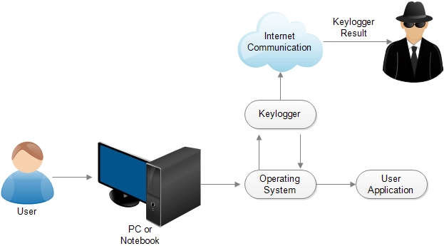
Block Diagram

Slide 20
Uses Of Keylogger:
Acceptable uses:
· Parent monitoring child’s computer usage
· Boss monitoring employee’s computer usage
· Government retrieving information pertinent to a crime
Malicious uses:
· Cracking passwords
· Gaining unauthorized information
· Stealing credit card numbers
· Reading sent emails or messages not intended for public viewing
· Retrieving secret names
. Stealing account numbers

Slide 21
Advantages
Companies can monitor their employees on what other activities they do on the computer during work.
To know what activities students, do in college.
Parents can keep an eye on their children whether they are doing something wrong or they are not going towards any wrong path.
Differentiate between Productivity and Idleness
Less risk of Data theft

Slide 22
Limitations
Keyloggers are programs or devices that log keystrokes. Keyloggers are dangerous because they specifically read out login data such as names and passwords, and transmit them to unauthorized third parties. This threatens the security of your e-mail passwords, social media accounts, and online banking data.
You don't know they've breached your computer; and depending on what kind of keylogger it is, it can steal any passwords you've entered, periodically take screen shots, record the web pages you view, grab on to your sent emails and any instant messaging sessions, as well as sensitive financial information.
They can damage business relationships, financial standing, and reputation as a result. They can even cause an organisation to breach major pieces of legislation such as the Data Protection or Sarbanes Oxley Acts. And it's not just large corporates that experience keylogging attacks.

Slide 23
PROPOSED METHOD FOR KEYLOGGER DETECTION AND PREVENTION
Hackers make use of malwares to breach the security of a system. Malware can be keylogger, spyware, rootkit etc. They can also come in combination i. e. keylogger spyware as a common program. In this project we have proposed a method for detecting and preventing keylogger spyware attacks. The proposed method is expected to detect and defend against such kinds attacks.
The malware attack becomes very deadly if they are used in a combination. In this work we have designed an attacking scenario for keylogger spyware, a combination of keylogger and spyware program. The keylogger script stores every keystroke into a file and generates a log file then the spy script email this log file to the designer’s specified address.

Slide 24
Hardware Unit
Hardware-based keyloggers can monitor your activities without any software being installed at all. Examples of these include:
Keyboard hardware - These loggers take the form of a piece of hardware inserted somewhere between the computer keyboard and the computer, typically along the keyboard's cable connection. There are of course more advanced implementation methods that would prevent any device from being visible externally. This type of hardware keylogger is advantageous because it is not dependent on any software nor can it be detected by any software.
Wireless keyboard sniffers - It is possible for the signals sent from a wireless keyboard to its receiver to be intercepted by a wireless sniffer.
Keyboard overlays - Overlays are popular in ATM theft cases where thieves capture a user's PIN number. This device is designed to blend in with the machine so that people are unaware of its presence.

Slide 25
Software Unit
Software keyloggers are computer programs that install onto your device’s hard drive. Common keylogger software types may include:
API-based keyloggers directly eavesdrop between the signals sent from each keypress to the program you’re typing into. Application programming interfaces (APIs) allow software developers and hardware manufacturers to speak the same “language” and integrate with each other. API keyloggers quietly intercept keyboard APIs, logging each keystroke in a system file.
“Form grabbing”-based keyloggers eavesdrop all text entered into website forms once you send it to the server. Data is recorded locally before it is transmitted online to the web server.
Kernel-based keyloggers work their way into the system’s core for admin-level permissions. These loggers can bypass and get unrestricted access to everything entered in your system.

Slide 26
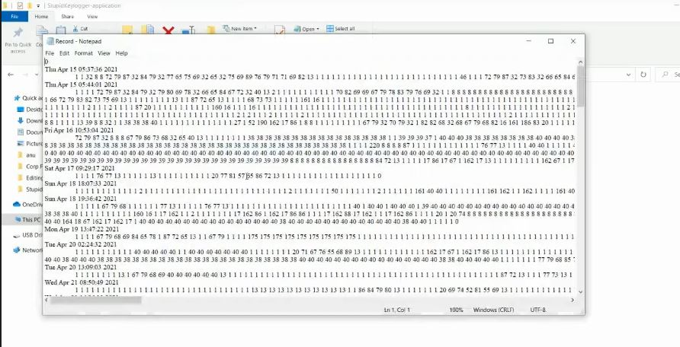

Slide 27
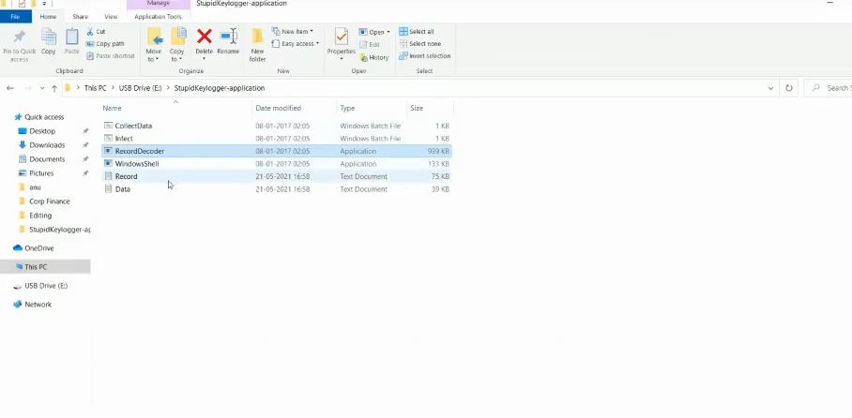

Slide 28
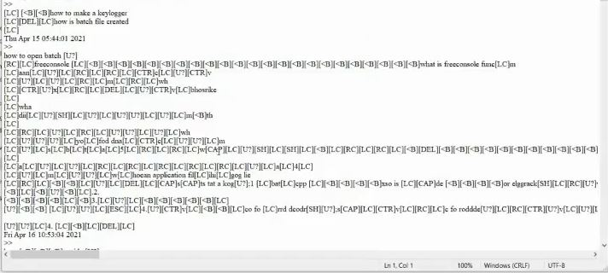

Slide 29
Summary
Keyloggers prose one of the largest threats to computer and network systems. Most everything that users protect on computers is protected by usernames and passwords. Keyloggers basically bypass these setup safety protocols making their data completely vulnerable.
In order to prevent keyloggers from recording sensitive data such as passwords, usernames, bank account number, and others alike we follow various prevention mechanisms. These include incorporating various encryption algorithms like Blowfish algorithm, AES Encryption, RSA Encryption etc

Slide 30
References
https://securelist.com/keyloggers-how-they-work-and-how-to-detect-them-part-1/36138/
https://www.kaspersky.co.in/resource-center/definitions/keylogger
https://home.sophos.com/en-us/security-news/2019/what-is-a-keylogger.aspx
https://link.springer.com/content/pdf/10.1007%2F978-3-642-04444-1_1.pdf
https://www.ijedr.org/papers/IJEDR1402115.pdf
[4]
Notes:
y

